Slide 1
CS162 Operating Systems and Systems Programming Lecture 4 Abstractions 2: Files and I/O A quick programmer’s viewpoint
September 9th, 2020
Prof. John Kubiatowicz
http://cs162.eecs.Berkeley.edu

Slide 2
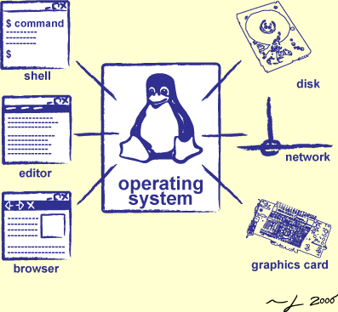
Goals for Today: The File Abstraction
Finish discussion of process management
High-Level File I/O: Streams
Low-Level File I/O: File Descriptors
How and Why of High-Level File I/O
Process State for File Descriptors
Common Pitfalls with OS Abstractions

Slide 3
Recall: Synchronization between threads
Mutual Exclusion: Ensuring only one thread does a particular thing at a time (one thread excludes the others)
Critical Section: Code that exactly one thread can execute at once
Result of mutual exclusion
Lock: An object only one thread can hold at a time
Provides mutual exclusion
Offers two atomic operations:
Lock.Acquire() – wait until lock is free; then grab
Lock.Release() – Unlock, wake up waiters
Need other tools for “cooperation”
e.g., semaphores

Slide 4
Semaphores: A quick look
Semaphores are a kind of generalized lock
First defined by Dijkstra in late 60s
Main synchronization primitive used in original UNIX (& Pintos)
Definition: a Semaphore has a non-negative integer value and supports the following two operations:
P() or down(): atomic operation that waits for semaphore to become positive, then decrements it by 1
V() or up(): an atomic operation that increments the semaphore by 1, waking up a waiting P, if any
P() stands for “proberen” (to test) and V() stands for “verhogen” (to increment) in Dutch

Slide 5
Two Semaphore Patterns
Mutual Exclusion: (like lock)
Called a "binary semaphore“ or “mutex”
initial value of semaphore = 1;
semaphore.down(); // Critical section goes here semaphore.up();
Signaling other threads, e.g. ThreadJoin
Initial value of semaphore = 0
ThreadJoin {
semaphore.down(); }
ThreadFinish {
semaphore.up(); }

Slide 6
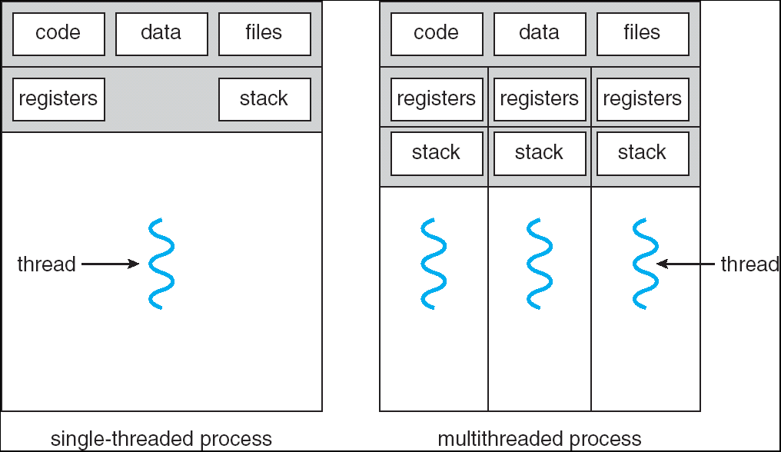
Recall: Processes
Definition: execution environment with restricted rights
One or more threads executing in a single address space
Owns file descriptors, network connections
Instance of a running program
When you run an executable, it runs in its own process
Application: one or more processes working together
Protected from each other; OS protected from them
In modern OSes, anything that runs outside of the kernel runs in a process

Slide 7
Recall: Creating Processes
pid_t fork() – copy the current process
New process has different pid
New process contains a single thread
Return value from fork(): pid (like an integer)
When > 0:
Running in (original) Parent process
return value is pid of new child
When = 0:
Running in new Child process
When < 0:
Error! Must handle somehow
Running in original process
State of original process duplicated in both Parent and Child!
Address Space (Memory), File Descriptors (covered later), etc…

Slide 8
Recall: fork_race.c
int i;
pid_t cpid = fork();
if (cpid > 0) {
for (i = 0; i < 10; i++) {
printf("Parent: %d\n", i);
// sleep(1);
}
} else if (cpid == 0) {
for (i = 0; i > -10; i--) {
printf("Child: %d\n", i);
// sleep(1);
}
} else { /* ERROR! */ }
What does this print?
Would adding the calls to sleep() matter?
Parent Process
Runs HERE!
Child Process
Runs HERE!

Slide 9
Recall: Start new Program with exec
…
cpid = fork();
if (cpid > 0) { /* Parent Process */
tcpid = wait(&status);
} else if (cpid == 0) { /* Child Process */
char *args[] = {“ls”, “-l”, NULL};
execv(“/bin/ls”, args);
/* execv doesn’t return when it works.
So, if we got here, it failed! */
perror(“execv”);
exit(1);
}
…

Slide 10
Starting New Program (for instance in Shell)
child
pid=fork();
if (pid==0)
exec(…);
else
wait(&stat)
main() {
…
}
exec
fork
pid=fork();
if (pid==0)
exec(…);
else
wait(&stat)
parent
pid=fork();
if (pid==0)
exec(…);
else
wait(&stat)
wait
fork

Slide 11
Finishing up: Process Management API
exit – terminate a process
fork – copy the current process
exec – change the program being run by the current process
wait – wait for a process to finish
kill – send a signal (interrupt-like notification) to another process
sigaction – set handlers for signals

Slide 12
fork2.c – parent waits for child to finish
int status;
pid_t tcpid;
…
cpid = fork();
if (cpid > 0) { /* Parent Process */
mypid = getpid();
printf("[%d] parent of [%d]\n", mypid, cpid);
tcpid = wait(&status);
printf("[%d] bye %d(%d)\n", mypid, tcpid, status);
} else if (cpid == 0) { /* Child Process */
mypid = getpid();
printf("[%d] child\n", mypid);
exit(42);
}
…

Slide 13
Finishing up: Process Management API
exit – terminate a process
fork – copy the current process
exec – change the program being run by the current process
wait – wait for a process to finish
kill – send a signal (interrupt-like notification) to another process
sigaction – set handlers for signals

Slide 14
inf_loop.c
#include <stdlib.h>
#include <stdio.h>
#include <sys/types.h>
#include <unistd.h>
#include <signal.h>
void signal_callback_handler(int signum) {
printf(“Caught signal!\n”);
exit(1);
}
int main() {
struct sigaction sa;
sa.sa_flags = 0;
sigemptyset(&sa.sa_mask);
sa.sa_handler = signal_callback_handler;
sigaction(SIGINT, &sa, NULL);
while (1) {}
}
Q: What would happen if the process receives a SIGINT signal, but does not register a signal handler?
A: The process dies!
For each signal, there is a default handler defined by the system

Slide 15
Common POSIX Signals
SIGINT – control-C
SIGTERM – default for kill shell command
SIGSTP – control-Z (default action: stop process)
SIGKILL, SIGSTOP – terminate/stop process
Can’t be changed with sigaction
Why?

Slide 16
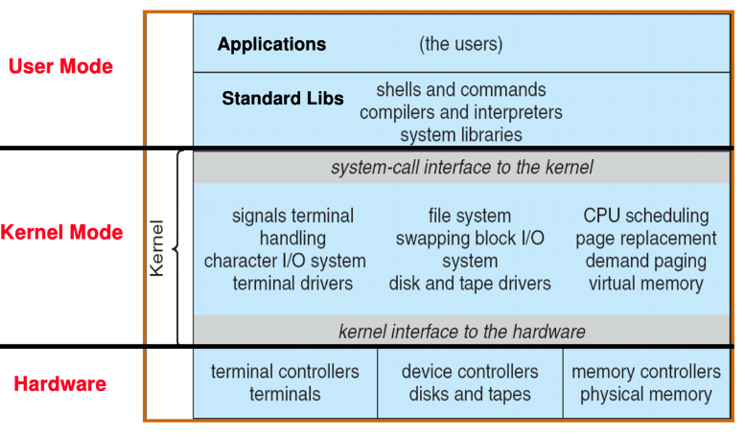
Recall: UNIX System Structure

Slide 17
Recall: System Calls (“Syscalls”)
Word Processing
Compilers
Web Browsers
Email
Databases
Web Servers
Application / Service
Portable OS Library
OS
User
System Call
Interface
System
Portable OS Kernel
Software
Platform support, Device Drivers
Hardware
x86
PowerPC
ARM
PCI
Ethernet (1Gbs/10Gbs)
802.11 a/g/n/ac
SCSI
Graphics
Thunderbolt

Slide 18
Recall: OS Library Issues Syscalls
Proc 1
Proc 2
Proc n
…
OS
Appln
login
Window Manager
…
libc
OS library
OS library
OS library
OS

Slide 19

Administrivia: Game On!
Project 0 due today!
To be done on your own – like a homework!
Slip days: I’d bank these and not spend them right away!
No credit when late and run out of slip days
Group assignment in process (preferences were due Monday night)
Plan on attending your permanent discussion section this Friday
Remember to turn on your camera in Zoom
Discussion section attendance is mandatory
Midterm 1: October 1st, 5-7PM (Three weeks from tomorrow!)
We understand that this partially conflicts with CS170, but those of you in CS170 can start that exam after 7PM (according to CS170 staff)
Video Proctored, No curve, Use of computer to answer questions
More details as we get closer to exam
Start Planning on how your group will collaborate on projects!
Virtual Coffee Hours with your group (with camera)
Regular Brainstorming meetings?
Try to meet multiple times a week
Hello!
Hi!

Slide 20
What does pthread stand for?
pthread library: POSIX thread library
POSIX: Portable Operating System Interface (for uniX?)
Interface for application programmers (mostly)
Defines the term “Unix,” derived from AT&T Unix
Created to bring order to many Unix-derived OSes, so applications are portable
Partially available on non-Unix OSes, like Windows
Requires standard system call interface

Slide 21
Unix/POSIX Idea: Everything is a “File”
Identical interface for:
Files on disk
Devices (terminals, printers, etc.)
Regular files on disk
Networking (sockets)
Local interprocess communication (pipes, sockets)
Based on the system calls open(), read(), write(), and close()
Additional: ioctl() for custom configuration that doesn’t quite fit
Note that the “Everything is a File” idea was a radical idea when proposed
Dennis Ritchie and Ken Thompson described this idea in their seminal paper on UNIX called “The UNIX Time-Sharing System” from 1974
I posted this on the resources page if you are curious

Slide 22
The File System Abstraction
File
Named collection of data in a file system
POSIX File data: sequence of bytes
Could be text, binary, serialized objects, …
File Metadata: information about the file
Size, Modification Time, Owner, Security info, Access control
Directory
“Folder” containing files & directories
Hierachical (graphical) naming
Path through the directory graph
Uniquely identifies a file or directory
/home/ff/cs162/public_html/fa14/index.html
Links and Volumes (later)

Slide 23
Connecting Processes, File Systems, and Users
Every process has a current working directory (CWD)
Can be set with system call: int chdir(const char *path); //change CWD
Absolute paths ignore CWD
/home/oski/cs162
Relative paths are relative to CWD
index.html, ./index.html
Refers to index.html in current working directory
../index.html
Refers to index.html in parent of current working directory
~/index.html, ~cs162/index.html
Refers to index.html in the home directory

Slide 24

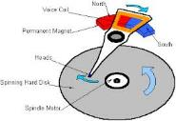




I/O and Storage Layers
Application / Service
Streams
High Level I/O
Low Level I/O
File Descriptors
Focus of today’s lecture
Syscall
open(), read(), write(), close(), …
Open File Descriptions
File System
Files/Directories/Indexes
I/O Driver
Commands and Data Transfers
Disks, Flash, Controllers, DMA

Slide 25
Today: The File Abstraction
High-Level File I/O: Streams
Low-Level File I/O: File Descriptors
How and Why of High-Level File I/O
Process State for File Descriptors
Common Pitfalls with OS Abstractions

Slide 26
C High-Level File API – Streams
Operates on “streams” – unformatted sequences of bytes (wither text or binary data), with a position:
Open stream represented by pointer to a FILE data structure
Error reported by returning a NULL pointer
#include <stdio.h>
FILE *fopen( const char *filename, const char *mode );
int fclose( FILE *fp );
Mode Text | Binary | Descriptions
r | rb | Open existing file for reading
w | wb | Open for writing; created if does not exist
a | ab | Open for appending; created if does not exist
r+ | rb+ | Open existing file for reading & writing.
w+ | wb+ | Open for reading & writing; truncated to zero if exists, create otherwise
a+ | ab+ | Open for reading & writing. Created if does not exist. Read from beginning, write as append

Slide 27
C API Standard Streams – stdio.h
Three predefined streams are opened implicitly when the program is executed.
FILE *stdin – normal source of input, can be redirected
FILE *stdout – normal source of output, can too
FILE *stderr – diagnostics and errors
STDIN / STDOUT enable composition in Unix
All can be redirected
cat hello.txt | grep “World!”
cat’s stdout goes to grep’s stdin

Slide 28
C High-Level File API
// character oriented
int fputc( int c, FILE *fp ); // rtn c or EOF on err
int fputs( const char *s, FILE *fp ); // rtn > 0 or EOF
int fgetc( FILE * fp );
char *fgets( char *buf, int n, FILE *fp );
// block oriented
size_t fread(void *ptr, size_t size_of_elements,
size_t number_of_elements, FILE *a_file);
size_t fwrite(const void *ptr, size_t size_of_elements,
size_t number_of_elements, FILE *a_file);
// formatted
int fprintf(FILE *restrict stream, const char *restrict format, ...);
int fscanf(FILE *restrict stream, const char *restrict format, ... );

Slide 29
C Streams: Char-by-Char I/O
int main(void) {
FILE* input = fopen(“input.txt”, “r”);
FILE* output = fopen(“output.txt”, “w”);
int c;
c = fgetc(input);
while (c != EOF) {
fputc(output, c);
c = fgetc(input);
}
fclose(input);
fclose(output);
}

Slide 30
C High-Level File API
// character oriented
int fputc( int c, FILE *fp ); // rtn c or EOF on err
int fputs( const char *s, FILE *fp ); // rtn > 0 or EOF
int fgetc( FILE * fp );
char *fgets( char *buf, int n, FILE *fp );
// block oriented
size_t fread(void *ptr, size_t size_of_elements,
size_t number_of_elements, FILE *a_file);
size_t fwrite(const void *ptr, size_t size_of_elements,
size_t number_of_elements, FILE *a_file);
// formatted
int fprintf(FILE *restrict stream, const char *restrict format, ...);
int fscanf(FILE *restrict stream, const char *restrict format, ... );

Slide 31
C Streams: Block-by-Block I/O
#define BUFFER_SIZE 1024
int main(void) {
FILE* input = fopen("input.txt", "r");
FILE* output = fopen("output.txt", "w");
char buffer[BUFFER_SIZE];
size_t length;
length = fread(buffer, BUFFER_SIZE, sizeof(char), input);
while (length > 0) {
fwrite(buffer, length, sizeof(char), output);
length = fread(buffer, BUFFER_SIZE, sizeof(char), input);
}
fclose(input);
fclose(output);
}

Slide 32
Aside: System Programming
Systems programmers should always be paranoid!
Otherwise you get intermittently buggy code
We should really be writing things like:
FILE* input = fopen(“input.txt”, “r”);
if (input == NULL) {
// Prints our string and error msg.
perror(“Failed to open input file”)
}
Be thorough about checking return values!
Want failures to be systematically caught and dealt with
I may be a bit loose with error checking for examples in class (to keep short)
Do as I say, not as I show in class!

Slide 33
C High-Level File API: Positioning The Pointer
int fseek(FILE *stream, long int offset, int whence);
long int ftell (FILE *stream)
void rewind (FILE *stream)
For fseek(), the offset is interpreted based on the whence argument (constants in stdio.h):
SEEK_SET: Then offset interpreted from beginning (position 0)
SEEK_END: Then offset interpreted backwards from end of file
SEEK_CUR: Then offset interpreted from current position
Overall preserves high-level abstraction of a uniform stream of objects
offset (SEEK_SET)
offset (SEEK_END)
whence
offset (SEEK_CUR)

Slide 34
Today: The File Abstraction
High-Level File I/O: Streams
Low-Level File I/O: File Descriptors
How and Why of High-Level File I/O
Process State for File Descriptors
Common Pitfalls with OS Abstractions [if time]

Slide 35
Key Unix I/O Design Concepts
Uniformity – everything is a file
file operations, device I/O, and interprocess communication through open, read/write, close
Allows simple composition of programs
find | grep | wc …
Open before use
Provides opportunity for access control and arbitration
Sets up the underlying machinery, i.e., data structures
Byte-oriented
Even if blocks are transferred, addressing is in bytes
Kernel buffered reads
Streaming and block devices looks the same, read blocks yielding processor to other task
Kernel buffered writes
Completion of out-going transfer decoupled from the application, allowing it to continue
Explicit close

Slide 36
Low-Level File I/O: The RAW system-call interface
#include <fcntl.h>
#include <unistd.h>
#include <sys/types.h>
int open (const char *filename, int flags [, mode_t mode])
int creat (const char *filename, mode_t mode)
int close (int filedes)
Bit vector of:
Access modes (Rd, Wr, …)
Open Flags (Create, …)
Operating modes (Appends, …)
Bit vector of Permission Bits:
User|Group|Other X R|W|X
Integer return from open() is a file descriptor
Error indicated by return < 0: the global errno variable set with error (see man pages)
Operations on file descriptors:
Open system call created an open file description entry in system-wide table of open files
Open file description object in the kernel represents an instance of an open file
Why give user an integer instead of a pointer to the file description in kernel?

Slide 37
C Low-Level (pre-opened) Standard Descriptors
#include <unistd.h>
STDIN_FILENO - macro has value 0
STDOUT_FILENO - macro has value 1
STDERR_FILENO - macro has value 2
// Get file descriptor inside FILE *
int fileno (FILE *stream)
// Make FILE * from descriptor
FILE * fdopen (int filedes, const char *opentype)

Slide 38
Low-Level File API
Read data from open file using file descriptor: ssize_t read (int filedes, void *buffer, size_t maxsize)
Reads up to maxsize bytes – might actually read less!
returns bytes read, 0 => EOF, -1 => error
Write data to open file using file descriptor ssize_t write (int filedes, const void *buffer, size_t size)
returns number of bytes written
Reposition file offset within kernel (this is independent of any position held by high-level FILE descriptor for this file! off_t lseek (int filedes, off_t offset, int whence)

Slide 39
Example: lowio.c
int main() {
char buf[1000];
int fd = open("lowio.c", O_RDONLY, S_IRUSR | S_IWUSR);
ssize_t rd = read(fd, buf, sizeof(buf));
int err = close(fd);
ssize_t wr = write(STDOUT_FILENO, buf, rd);
}
How many bytes does this program read?

Slide 40
POSIX I/O: Design Patterns
Open before use
Access control check, setup happens here
Byte-oriented
Least common denominator
OS responsible for hiding the fact that real devices may not work this way (e.g. hard drive stores data in blocks)
Explicit close

Slide 41
POSIX I/O: Kernel Buffering
Reads are buffered inside kernel
Part of making everything byte-oriented
Process is blocked while waiting for device
Let other processes run while gathering result
Writes are buffered inside kernel
Complete in background (more later on)
Return to user when data is “handed off” to kernel
This buffering is part of global buffer management and caching for block devices (such as disks)
Items typically cached in quanta of disk block sizes
We will have many interesting things to say about this buffering when we dive into the kernel

Slide 42
Low-Level I/O: Other Operations
Operations specific to terminals, devices, networking, …
e.g., ioctl
Duplicating descriptors
int dup2(int old, int new);
int dup(int old);
Pipes – channel
int pipe(int pipefd[2]);
Writes to pipefd[1] can be read from pipefd[0]
File Locking
Memory-Mapping Files
Asynchronous I/O

Slide 43
Today: The File Abstraction
High-Level File I/O: Streams
Low-Level File I/O: File Descriptors
How and Why of High-Level File I/O
Process State for File Descriptors
Some Pitfalls with OS Abstractions [if time]

Slide 44
High-Level vs. Low-Level File API
High-Level Operation:
Low-Level Operation:
size_t fread(…) {
Do some work like a normal fn…
asm code … syscall # into %eax
put args into registers %ebx, …
special trap instruction
ssize_t read(…) {
asm code … syscall # into %eax
put args into registers %ebx, …
special trap instruction
Kernel:
Kernel:
get args from regs
dispatch to system func
Do the work to read from the file
Store return value in %eax
get args from regs
dispatch to system func
Do the work to read from the file
Store return value in %eax
get return values from regs
Do some more work like a normal fn…
};
get return values from regs
};

Slide 45
High-Level vs. Low-Level File API
Streams are buffered in user memory: printf("Beginning of line ");
sleep(10); // sleep for 10 seconds
printf("and end of line\n");
Prints out everything at once
Operations on file descriptors are visible immediately
write(STDOUT_FILENO, "Beginning of line ", 18);
sleep(10);
write("and end of line \n", 16);
Outputs "Beginning of line" 10 seconds earlier than “and end of line”

Slide 46
What’s in a FILE?
What’s in the FILE* returned by fopen?
File descriptor (from call to open) <= Need this to interface with the kernel!
Buffer (array)
Lock (in case multiple threads use the FILE concurrently)
Of course there’s other stuff in a FILE too…
… but this is useful model to have

Slide 47
FILE Buffering
When you call fwrite, what happens to the data you provided?
It gets written to the FILE’s buffer
If the FILE’s buffer is full, then it is flushed
Which means it’s written to the underlying file descriptor
The C standard library may flush the FILE more frequently
e.g., if it sees a certain character in the stream
When you write code, make the weakest possible assumptions about how data is flushed from FILE buffers

Slide 48
Example
char x = ‘c’;
FILE* f1 = fopen(“file.txt”, “w”);
fwrite(“b”, sizeof(char), 1, f1);
FILE* f2 = fopen(“file.txt”, “r”);
fread(&x, sizeof(char), 1, f2);
The call to fread might see the latest write ‘b’
Or it might miss it and see end of file (in which case x will remain ‘c’)

Slide 49
Example
char x = ‘c’;
FILE* f1 = fopen(“file.txt”, “wb”);
fwrite(“b”, sizeof(char), 1, f1);
fflush(f1);
FILE* f2 = fopen(“file.txt”, “rb”);
fread(&x, sizeof(char), 1, f2);
Now, the call to fread will definitely see the latest write ‘b’

Slide 50
Writing Correct Code with FILE
Your code should behave correctly regardless of when C Standard Library flushes its buffer
Add your own calls to fflush so that data is written when you need to
Calls to fclose flush the buffer before deallocating memory and closing the file descriptor
With the low-level file API, we don’t have this problem
After write completes, data is visible to any subsequent reads

Slide 51
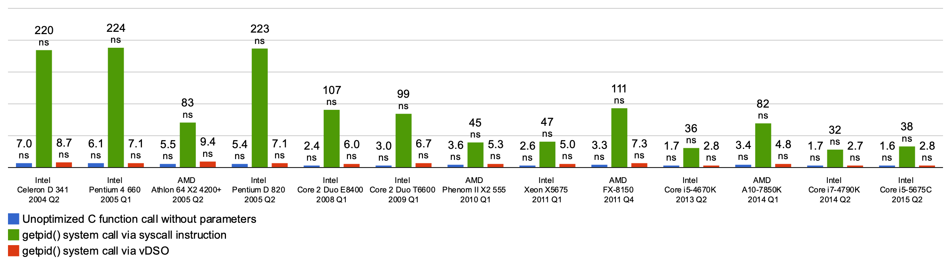
Why Buffer in Userspace? Overhead!
Syscalls are 25x more expensive than function calls (~100 ns)
This example about special shared-memory interface to the getpid() functionality, but point is the same!
read/write a file byte by byte? Max throughput of ~10MB/second
With fgetc? Keeps up with your SSD

Slide 52
Why Buffer in Userspace? Functionality!
System call operations less capable
Simplifies operating system
Example: No “read until new line” operation in kernel
Why? Kernel agnostic about formatting!
Solution: Make a big read syscall, find first new line in userspace
i.e. use one of the following high-level options: char *fgets(char *s, int size, FILE *stream); ssize_t getline(char **lineptr, size_t *n, FILE *stream);

Slide 53
Today: The File Abstraction
High-Level File I/O: Streams
Low-Level File I/O: File Descriptors
How and Why of High-Level File I/O
Process State for File Descriptors
Some Pitfalls with OS Abstractions [if time]

Slide 54
I/O and Storage Layers
Application / Service
Streams
High Level I/O
Low Level I/O
File Descriptors
Focus of today’s lecture
Syscall
open(), read(), write(), close(), …
Open File Descriptions
File System
Files/Directories/Indexes
I/O Driver
Commands and Data Transfers
Disks, Flash, Controllers, DMA

Slide 55
State Maintained by the Kernel
Recall: On a successful call to open():
A file descriptor (int) is returned to the user
An open file description is created in the kernel
For each process, kernel maintains mapping from file descriptor to open file description
On future system calls (e.g., read()), kernel looks up open file description using file descriptor and uses it to service the system call: char buffer1[100];
char buffer2[100];
int fd = open(“foo.txt”, O_RDONLY);
read(fd, buffer1, 100);
read(fd, buffer2, 100);
The kernel remembers that the int it receives (stored in fd) corresponds to foo.txt
The kernel picks up where it left off in the file

Slide 56
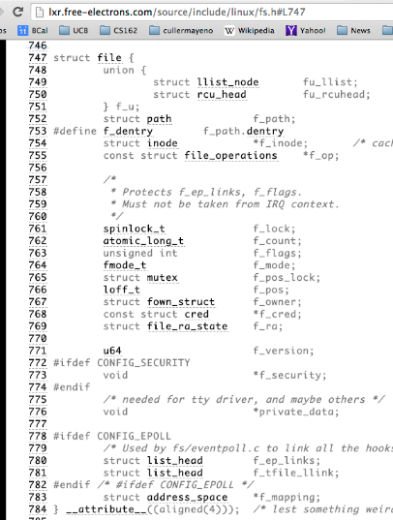
What’s in an Open File Description?
For our purposes, the two most important things are:
Where to find the file data on disk
The current position within the file

Slide 57
Abstract Representation of a Process
Process
Suppose that we execute
open(“foo.txt”)
and that the result is 3
Thread’s Regs
Address Space (Memory)
…
User Space
Kernel Space
File Descriptors
Open File Description
3
Not shown: Initially contains 0, 1, and 2 (stdin, stdout, stderr)
File: foo.txt
Position: 0

Slide 58
Abstract Representation of a Process
Process
Suppose that we execute
open(“foo.txt”)
and that the result is 3
Next, suppose that we execute
read(3, buf, 100)
and that the result is 100
Thread’s Regs
Address Space (Memory)
…
User Space
Kernel Space
File Descriptors
Open File Description
3
Not shown: Initially contains 0, 1, and 2 (stdin, stdout, stderr)
File: foo.txt
Position: 0

Slide 59
Abstract Representation of a Process
Process
Suppose that we execute
open(“foo.txt”)
and that the result is 3
Next, suppose that we execute
read(3, buf, 100)
and that the result is 100
Thread’s Regs
Address Space (Memory)
…
User Space
Kernel Space
File Descriptors
Open File Description
3
Not shown: Initially contains 0, 1, and 2 (stdin, stdout, stderr)
File: foo.txt
Position: 100

Slide 60
Abstract Representation of a Process
Process
Suppose that we execute
open(“foo.txt”)
and that the result is 3
Next, suppose that we execute
read(3, buf, 100)
and that the result is 100
Finally, suppose that we execute
close(3)
Thread’s Regs
Address Space (Memory)
…
User Space
Kernel Space
File Descriptors
Open File Description
3
Not shown: Initially contains 0, 1, and 2 (stdin, stdout, stderr)
File: foo.txt
Position: 100

Slide 61
Instead of Closing, let’s fork()!
Process 1
Process 2
Thread’s Regs
Address Space (Memory)
File descriptor is copied
Open file description is aliased
Thread’s Regs
Address Space (Memory)
…
…
User Space
Kernel Space
File Descriptors
File Descriptors
Open File Description
3
3
Not shown: Initially contains 0, 1, and 2 (stdin, stdout, stderr)
File: foo.txt
Position: 100

Slide 62
Open File Description is Aliased
Process 1
Process 2
read(3, buf, 100)
Thread’s Regs
Address Space (Memory)
Thread’s Regs
Address Space (Memory)
…
…
User Space
Kernel Space
File Descriptors
File Descriptors
Open File Description
3
3
Not shown: Initially contains 0, 1, and 2 (stdin, stdout, stderr)
File: foo.txt
Position: 100

Slide 63
Open File Description is Aliased
Process 1
Process 2
read(3, buf, 100)
Thread’s Regs
Address Space (Memory)
Thread’s Regs
Address Space (Memory)
…
…
User Space
Kernel Space
File Descriptors
File Descriptors
Open File Description
3
3
Not shown: Initially contains 0, 1, and 2 (stdin, stdout, stderr)
File: foo.txt
Position: 200

Slide 64
Open File Description is Aliased
Process 1
Process 2
read(3, buf, 100)
read(3, buf, 100)
Thread’s Regs
Address Space (Memory)
Thread’s Regs
Address Space (Memory)
…
…
User Space
Kernel Space
File Descriptors
File Descriptors
Open File Description
3
3
Not shown: Initially contains 0, 1, and 2 (stdin, stdout, stderr)
File: foo.txt
Position: 200

Slide 65
Open File Description is Aliased
Process 1
Process 2
read(3, buf, 100)
read(3, buf, 100)
Thread’s Regs
Address Space (Memory)
Thread’s Regs
Address Space (Memory)
…
…
User Space
Kernel Space
File Descriptors
File Descriptors
Open File Description
3
3
Not shown: Initially contains 0, 1, and 2 (stdin, stdout, stderr)
File: foo.txt
Position: 300

Slide 66
File Descriptor is Copied
Process 1
Process 2
read(3, buf, 100)
close(3)
read(3, buf, 100)
Thread’s Regs
Address Space (Memory)
Thread’s Regs
Address Space (Memory)
…
…
User Space
Kernel Space
File Descriptors
File Descriptors
Open File Description
3
3
Not shown: Initially contains 0, 1, and 2 (stdin, stdout, stderr)
File: foo.txt
Position: 300

Slide 67
File Descriptor is Copied
Process 1
Process 2
read(3, buf, 100)
close(3)
read(3, buf, 100)
Thread’s Regs
Address Space (Memory)
Thread’s Regs
Address Space (Memory)
Open file description remains alive until no file descriptors in any process refer to it
…
…
User Space
Kernel Space
File Descriptors
File Descriptors
Open File Description
3
Not shown: Initially contains 0, 1, and 2 (stdin, stdout, stderr)
File: foo.txt
Position: 300

Slide 68
Why is Aliasing the Open File Description a Good Idea?
It allows for shared resources between processes

Slide 69
Recall: In POSIX, Everything is a “File”
Identical interface for:
Files on disk
Devices (terminals, printers, etc.)
Regular files on disk
Networking (sockets)
Local interprocess communication (pipes, sockets)
Based on the system calls open(), read(), write(), and close()

Slide 70
Example: Shared Terminal Emulator
When you fork() a process, the parent’s and child’s printf outputs go to the same terminal

Slide 71
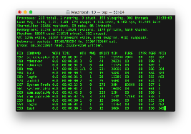
Example: Shared Terminal Emulator
Process 1
Process 2
Thread’s Regs
Address Space (Memory)
Thread’s Regs
Address Space (Memory)
…
…
User Space
Kernel Space
Terminal Emulator
File Descriptors
File Descriptors
0
1
2
0
1
2

Slide 72
Example: Shared Terminal Emulator
Process 1
Process 2
close(0)
Thread’s Regs
Address Space (Memory)
Thread’s Regs
Address Space (Memory)
…
…
User Space
Kernel Space
Terminal Emulator
File Descriptors
File Descriptors
0
1
2
0
1
2

Slide 73
Example: Shared Terminal Emulator
Process 1
Process 2
close(0)
Thread’s Regs
Address Space (Memory)
Thread’s Regs
Address Space (Memory)
If one process closes stdin (0), it remains open in other processes
…
…
User Space
Kernel Space
Terminal Emulator
File Descriptors
File Descriptors
0
1
2
0
1
2

Slide 74
Other Examples
Shared network connections after fork()
Allows handling each connection in a separate process
We’ll explore this next time
Shared access to pipes
Useful for interprocess communication
And in writing a shell (Homework 2)

Slide 75
Other Syscalls: dup and dup2
They allow you to duplicate the file descriptor
But the open file description remains aliased

Slide 76
Other Syscalls: dup and dup2
Process
Suppose that we execute
open(“foo.txt”)
and that the result is 3
Next, suppose that we execute
read(3, buf, 100)
and that the result is 100
Next, suppose that we execute
dup(3)
And that the result is 4
Finally, suppose that we execute
dup2(3, 162)
Thread’s Regs
Address Space (Memory)
…
User Space
Kernel Space
File Descriptors
Open File Description
3
4
162
Not shown: Initially contains 0, 1, and 2 (stdin, stdout, stderr)
File: foo.txt
Position: 100

Slide 77
Today: The File Abstraction
High-Level File I/O: Streams
Low-Level File I/O: File Descriptors
How and Why of High-Level File I/O
Process State for File Descriptors
Some Pitfalls with OS Abstractions [if time]

Slide 78
Don’t fork() in a process that already has multiple threads
Unless you plan to call exec() in the child process

Slide 79
fork() in Multithreaded Processes
The child process always has just a single thread
The thread in which fork() was called
The other threads just vanish

Slide 80
fork() in a Multithreaded Processes
Process 1
Process 2
Thread 1 Regs
Address Space (Memory)
Only the thread that called fork() exists in the new process
Thread 1 Regs
Address Space (Memory)
Thread 2 Regs
…
User Space
…
Kernel Space
File Descriptors
File Descriptors
Open File Description
3
3
Not shown: Initially contains 0, 1, and 2 (stdin, stdout, stderr)
File: foo.txt
Position: 100

Slide 81
Possible Problems with Multithreaded fork()
When you call fork() in a multithreaded process, the other threads (the ones that didn’t call fork()) just vanish
What if one of these threads was holding a lock?
What if one of these threads was in the middle of modifying a data structure?
No cleanup happens!
It’s safe if you call exec() in the child
Replacing the entire address space

Slide 82
Don’t carelessly mix low-level and high-level file I/O

Slide 83
Avoid Mixing FILE* and File Descriptors
char x[10];
char y[10];
FILE* f = fopen(“foo.txt”, “rb”);
int fd = fileno(f);
fread(x, 10, 1, f); // read 10 bytes from f
read(fd, y, 10); // assumes that this returns data starting at offset 10
Which bytes from the file are read into y?
Bytes 0 to 9
Bytes 10 to 19
None of these?
Answer: C! None of the above.
The fread() reads a big chunk of file into user-level buffer
Might be all of the file!

Slide 84
Be careful with fork() and FILE*

Slide 85
Be Careful Using fork() with FILE*
FILE* f = fopen(“foo.txt”, “w”);
fwrite(“a”, 1, 1, f);
fork();
fclose(f);
After all processes exit, what is in foo.txt?
Could be either a or aa
Usually aa based on what I’ve observed in Linux…
Depends on whether this fwrite() call flushes…

Slide 86
Be Careful Using fork() with FILE*
Process 1
Process 2
Thread’s Regs
Open File Description is aliased
But the FILE* buffer is copied!
Thread’s Regs
a
a
FILE* Buffer
FILE* Buffer
User Space
Kernel Space
File Descriptors
File Descriptors
Open File Description
3
3
Not shown: Initially contains 0, 1, and 2 (stdin, stdout, stderr)
File: foo.txt
Position: 0

Slide 87
Conclusion
Application / Service
High Level I/O
Streams
Low Level I/O
File Descriptors
Focus of today’s lecture
Syscall
open(), read(), write(), close(), …
Open File Descriptions
File System
Files/Directories/Indexes
I/O Driver
Commands and Data Transfers
Disks, Flash, Controllers, DMA

Slide 88
Conclusion
POSIX idea: “everything is a file”
All sorts of I/O managed by open/read/write/close
We added two new elements to the PCB:
Mapping from file descriptor to open file description
Current working directory

